Slide 1

Breast Cancer
Julie aranda​

Slide 2

Agenda
Comparative Analysis of Classifiers for Breast Cancer Prediction

Slide 3

Introduction
Originates in breast tissue
Commonly found in women
Survival ratio 1 in 39
Machine Learning techniques
Classifiers for cancer prediction
Random Forest, Decision Tree, Logistic Regression, SVM, XGB, and KNN

Slide 4

objective
Build a ml pipeline
Implement ml classifiers
Comparative analysis
Identify accurate & reliable classifier(s)
Context for cancer prediction

Slide 5
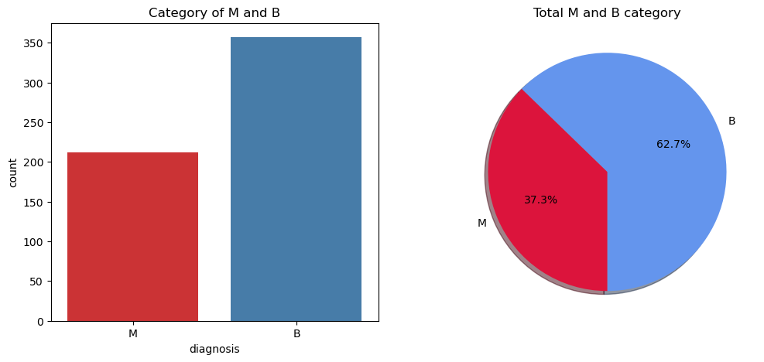
distribution of diagnosis categories

Slide 6
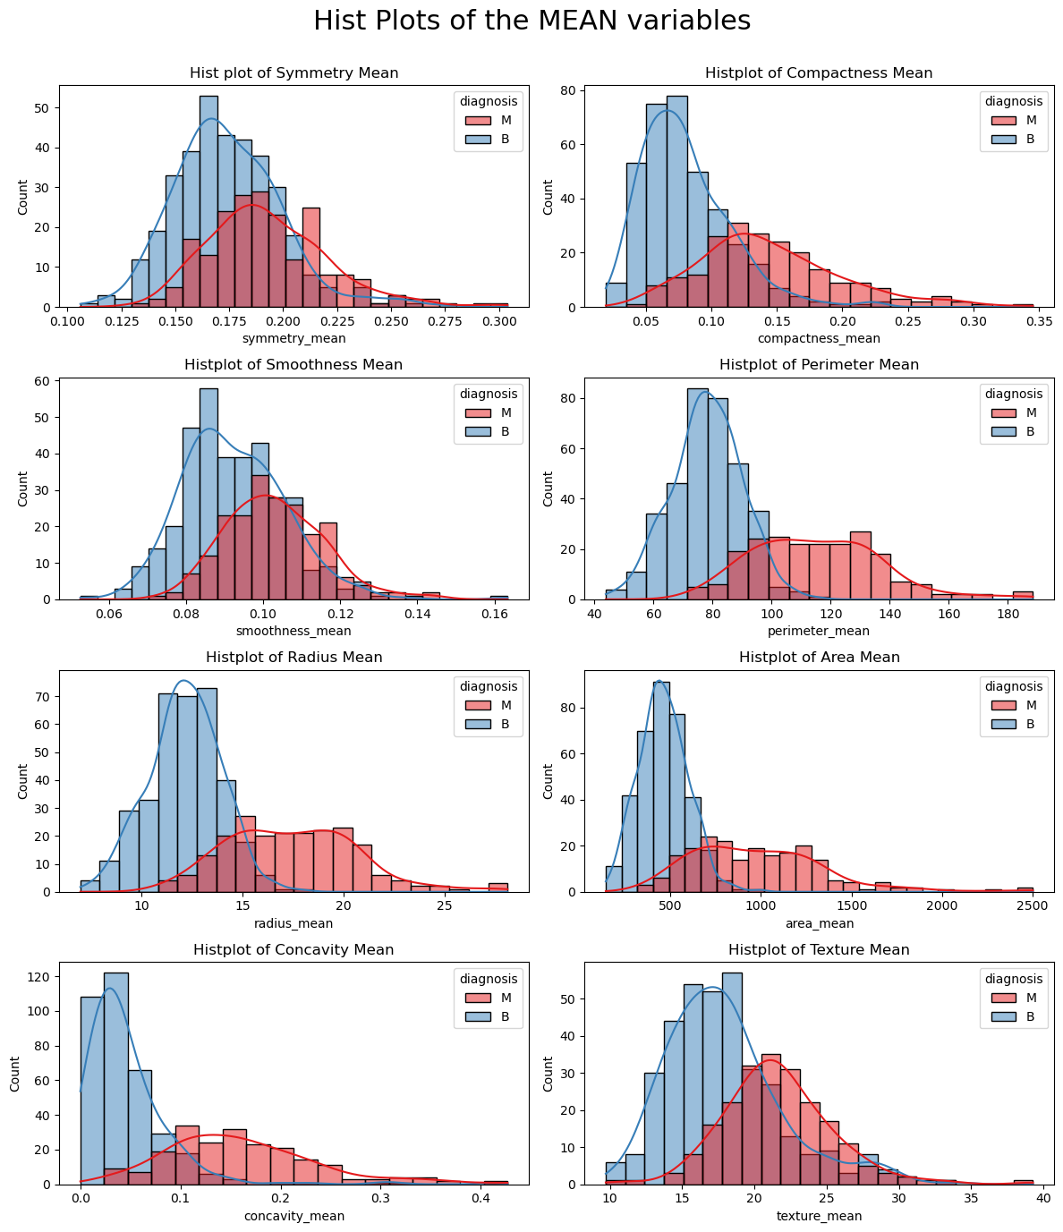

Slide 7
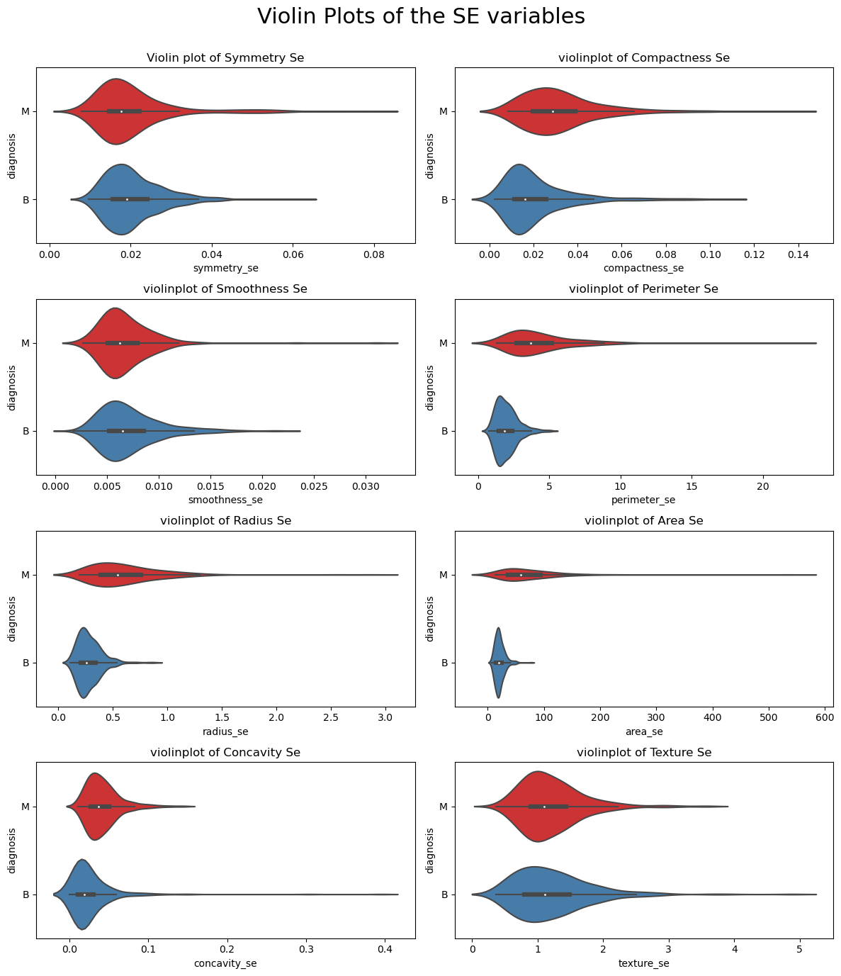

Slide 8
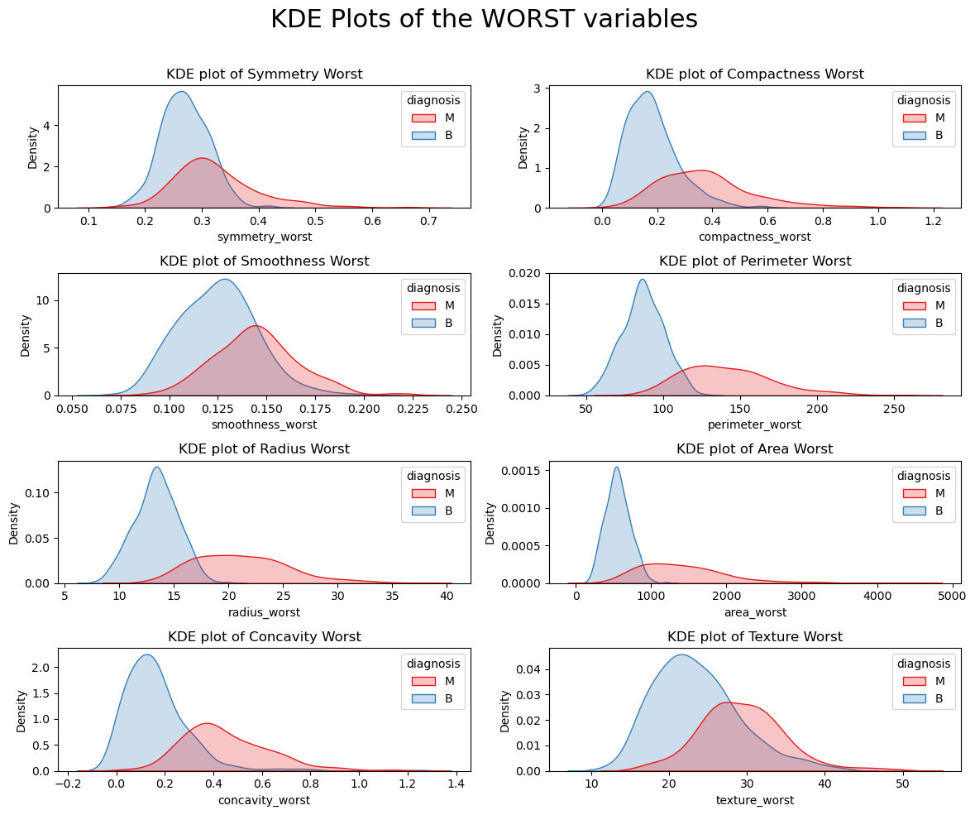

Slide 9
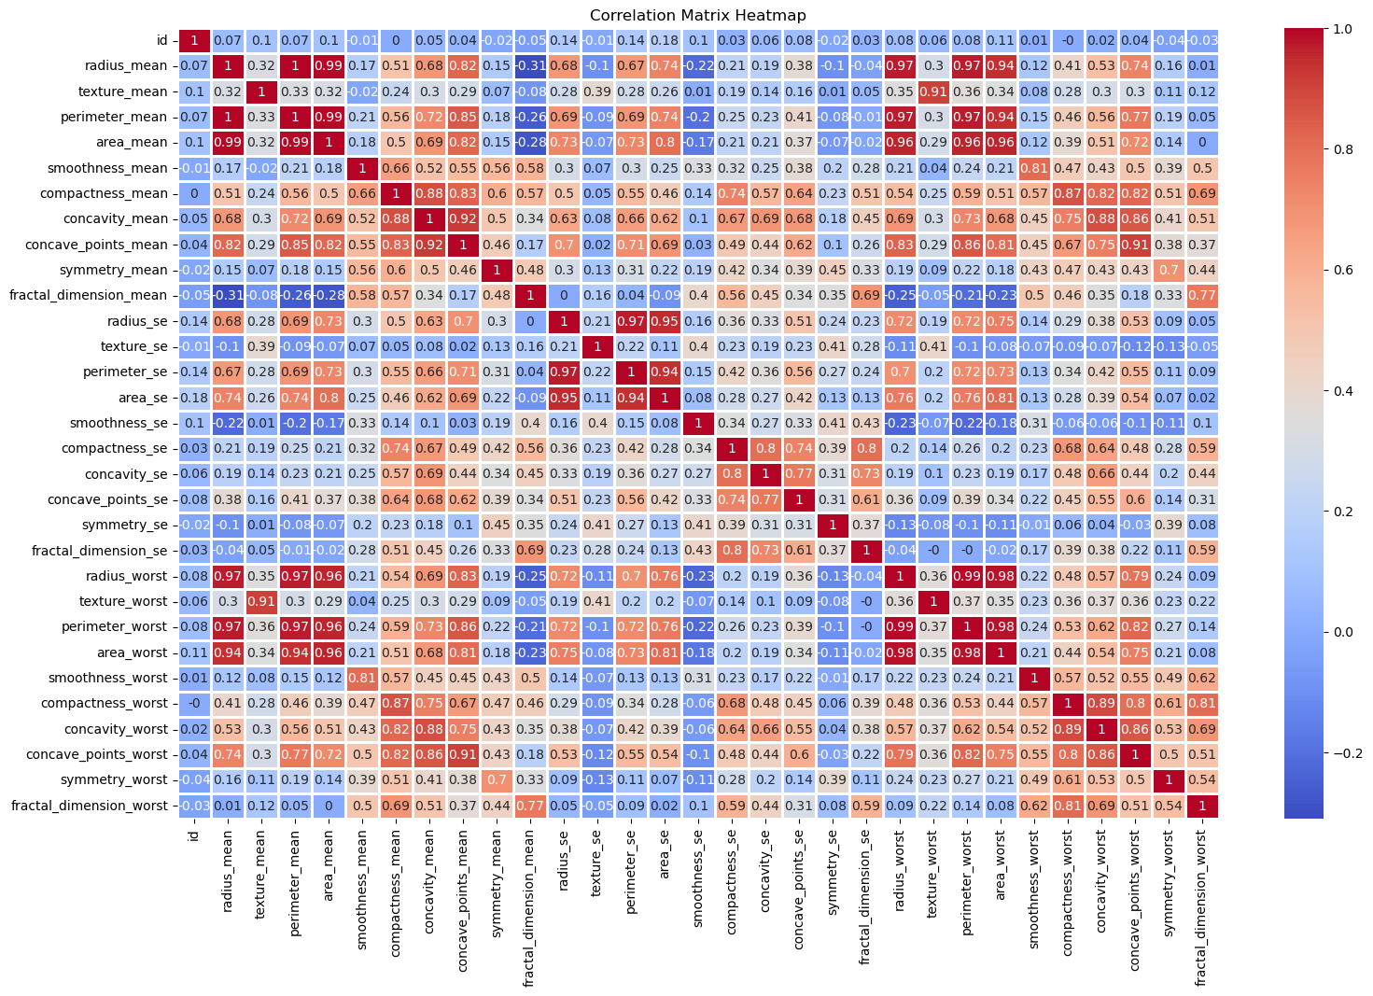

Slide 10
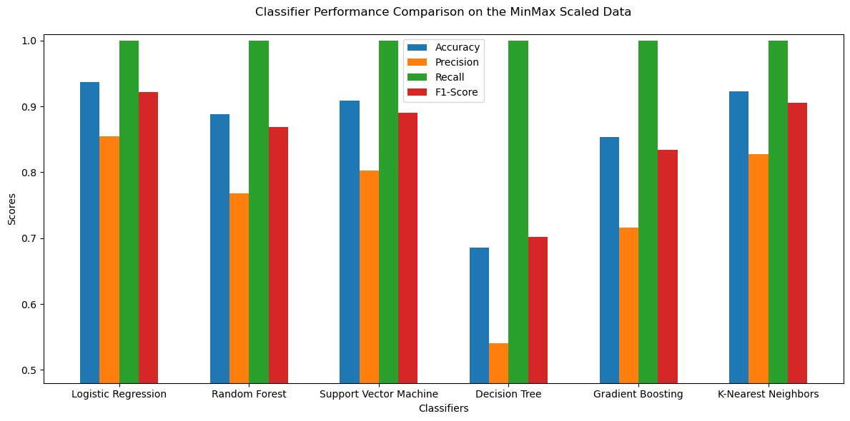








Meet our EXTENDED team
Takuma
Hayashi
Mirjam
Nilsson
Flora
Berggren
Rajesh
Santoshi
President
Chief Executive Officer
Chief Operations Officer
VP Marketing
Graham
Barnes
Rowan
Murphy
Elizabeth
Moore
Robin
Kline
VP Product
SEO Strategist
Product Designer
Content Developer

Slide 11
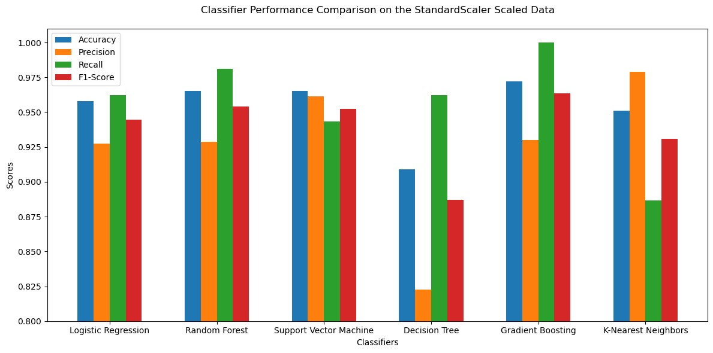

Plan for product launch
planning
marketing
design
strategy
Launch
Synergize scalable
e-commerce
Disseminate standardized metrics
Coordinate
e-business applications
Foster holistically superior methodologies
Deploy strategic networks with compelling
e-business needs

Slide 12

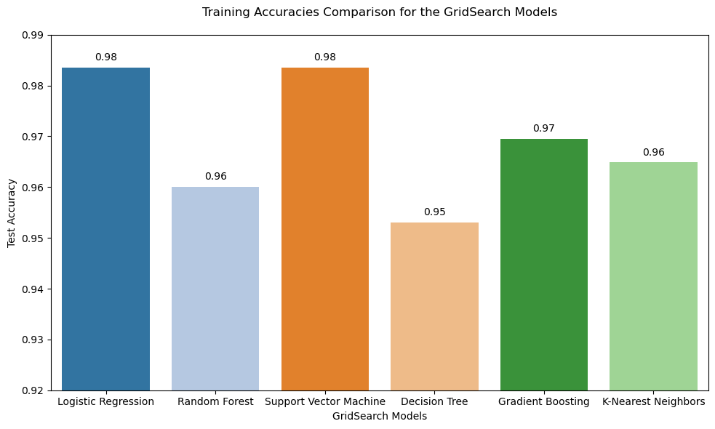
Timeline
Sep
oct
nov
dec
jan
Synergize scalable
e-commerce
Disseminate standardized
metrics
Coordinate
e-business applications
Foster holistically superior methodologies
Deploy strategic networks with compelling
e-business needs

Slide 13
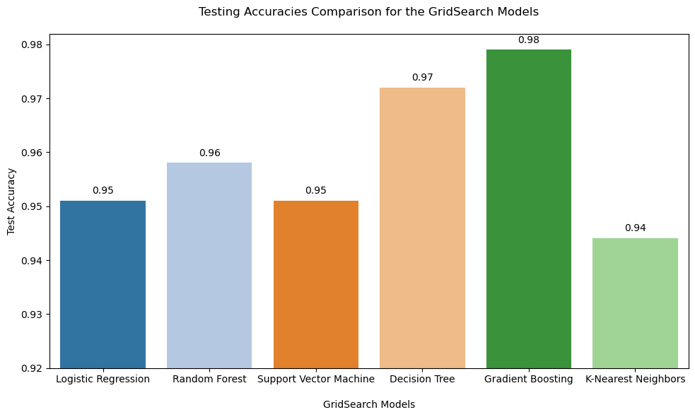

Areas of focus
B2B market
scenarios
Cloud-based opportunities
Develop winning strategies to keep ahead of the competition
Capitalize on low hanging fruit to identify a ballpark value
Visualize customer directed convergence
Iterative approaches to corporate strategy
Establish a management framework from the inside

Slide 14
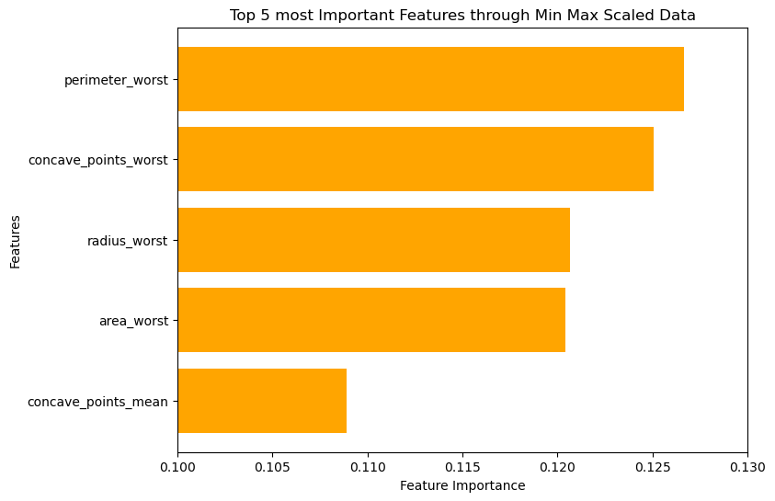


Slide 15

Summary
The choice of scaling method and classifier should be made based on the specific requirements and trade-offs in precision, recall, and F1-Score for the given classification problem.
The best classifier should consider both training & testing accuracies for the specific task.

Slide 16


Thank you

